Slide 1
Assignment Rules: Advanced Assignment
29 August 2011
Notes:
Assignment Rules: Advanced Assignment - <number>
Guidewire training materials contain Guidewire proprietary information that is subject to confidentiality and non-disclosure agreements. You agree to use the information in this manual solely for the purpose of training to implement Guidewire software solutions. You also agree not to disclose the information in this manual to third parties or copy this manual without prior written consent from Guidewire. Guidewire training may be given only by Guidewire employees or certified Guidewire partners under the appropriate agreement with Guidewire.

Slide 2
Lesson objectives
By the end of this lesson, you should be able to:
  Assign objects to users based on user attributes
  Understand conceptually how to assign objects to users based on dynamic groups
  This lesson uses the notes section for additional explanation and information.
  To view the notes in PowerPoint, choose View→Normal or View→Notes Page.
  If you choose to print the notes for the lesson, be sure to select “Print hidden slides.”
Notes:
Assignment Rules: Advanced Assignment - <number>

Slide 3
Lesson outline
Assignment based on user attributes
Dynamic assignment
Notes:
Assignment Rules: Advanced Assignment - <number>

Slide 4
Common assignment methods
Method | Object | Assigns To...
assignGroup() | Any | The named group
assignGroupByLocation() | Any | Group matching specified location and/or group type
assignGroupBy RoundRobin() | Any | The next child group within the parent group
assign() | Any | The named user
assignUserBy RoundRobin() | Any | The next user in the group (in a cyclical fashion)
assignUserByLocation() | Any | User matching location
assignToIssueOwner() | Exposure, Activity, Matter | The owner of the claim or related exposure
assignManually() | Claims | The group supervisor (who will assign claim manually)
assignActivityToQueue() | Activity | The named activity queue
assignByUserAttributes() | Any | A user which matches specified attributes
dynamic assignment | Any | Anything, depending on logic
Notes:
Assignment Rules: Advanced Assignment - <number>
The first three methods, which assign objects to groups, are discussed in the "Assignment Rules – Intro to Assignment" lesson.
The middle six methods, which assign objects to users (or to temporary holding places until a user takes ownership), are discussed in the "Assignment Rules - User Assignment" lesson.
The final two methods are discussed in this lesson.

Slide 5
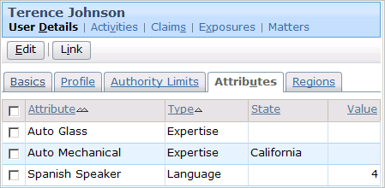
User attributes
Objects can be assigned to a user with a particular attribute (in a particular state and/or of a particular level)
  If there are multiple users with the desired attribute(s), objects are round-robined among those users
Notes:
Assignment Rules: Advanced Assignment - <number>
The attribute can be limited to a single state. The assignment rules can then search for a user with the given attribute in a given state (such as "find a user with auto mechanical expertise in California).
The attribute can have a value, or level of qualification. The assignment rules can then search for a user with the given attribute at the given level (such as "find a user who is a Spanish speaker at level 4 or higher.)
Ideally, whenever there is a user assignment based on attributes, there is more than one user with the required attributes. ClaimCenter automatically uses round robining with user attribute assignment. (For example, if there are 27 users with the "Spanish Speaking" attribute, then the first object goes to the first Spanish Speaking user, the second object goes to the second user, and so on.)

Slide 6
Assignment by user attribute strategy
AttributeBasedAssignmentCriteria
AutoGlass
AutoMechanical
SpanishSpeaker
assignByUserAttributes method requires object of type "AttributeBasedAssignmentCriteria"
  Contains array of attribute criteria elements
Before you can call method, you must create assignment criteria object
Notes:
Assignment Rules: Advanced Assignment - <number>

Slide 7
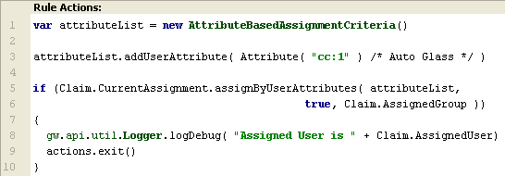
Creating assignment criteria object
Syntax:
var attribObj = new AttributeBasedAssignmentCriteria()
Notes:
Assignment Rules: Advanced Assignment - <number>
First, the assignment criteria object is created by calling the AttributeBasedAssignmentCriteria constructor.

Slide 8
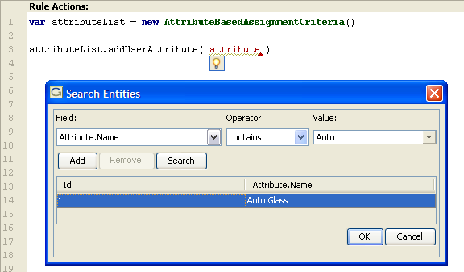
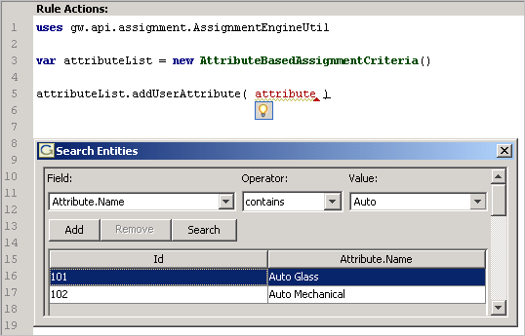
Adding attribute to criteria object (1)
Syntax:
attribObj.addUserAttributeCriteria(attribute)
Auto
Glass
1. Launch the query tool
2. Select the attribute property
3. Enter the attribute value
4. Search the data base
5. Select the attribute
6. Click OK
Notes:
Assignment Rules: Advanced Assignment - <number>
Next, search the database for the attribute to be used in the assignment. Once selected, scroll to the bottom of the Search Entities window and select OK.

Slide 9
Adding attribute to criteria object (2)
Syntax:
attribObj.addUserAttributeCriteria(attribute)
Auto
Glass
Notes:
Assignment Rules: Advanced Assignment - <number>
The Attribute’s database ID will be included, but it is recommended to comment the value of the attribute.

Slide 10
Assigning to user who matches criteria
Syntax:
object.CurrentAssignment.assignByUserAttributes(
attribObj, includeSubGroups, group)
Notes:
Assignment Rules: Advanced Assignment - <number>
Finally, the assignByUserAttributes method is executed. It takes the attribute criteria object, a boolean indicating whether to include users in the current group and its subgroups (true) or only users in the current group (false), and the current group. Typically, this is retrieved from <entity>.AssignedGroup.
Keep in mind that the attribute criteria object ("attributeList" in the example above) could have a single criterion or multiple criteria. In the example above, it has only a single criterion, "Auto Glass".
ClaimCenter attempts to find a user with the attribute(s) specified. If it can, it assigns the assignable object to that user and returns true. If it cannot, it returns false.

Slide 11
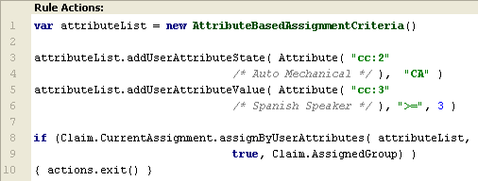
Using attribute state and value
Syntax:
attribObj. attribObj.addUserAttributeState( attribute, state)
attribObj. attribObj.addUserAttributeValue( attribute, operator, value)
Notes:
Assignment Rules: Advanced Assignment - <number>
You can add multiple criteria to a single attribute criteria object. The example above shows two criteria being added. When multiple criteria are included, they are ANDed together. A given user must have all the criteria in order to have the object assigned to him or her.
In the example above, the user must have the "Auto Mechanical" attribute for the state of California AND the "Spanish Speaker" attribute at a value of 3 or greater.
You can also add a criterion which is both state-dependent and value-dependent. To do this, you must use the addUserAttributeStateValue method and include the criteria object's Attribute field and then both a state and an operator/value pair.
For example, this attribute requires a Spanish Speaker in the state of NY with a rating of greater than 5:
attributeList.addUserAttributeStateValue( Attribute ( "cc:3" /*Spanish Speaker*/ ), "NY", ">", 5 )

Slide 12
If multiple users have desired attribute(s)
Peter Beebe
(Spanish Speaker)
Leroy Martel
(Spanish Speaker)
Dana Evans
(Spanish Speaker)
If multiple users match single attribute criteria list, then assignment "round-robins" through those users
  Users do not have to be in same group
  For round-robining outside of assignUserByRoundRobin, load factors are ignored
Notes:
Assignment Rules: Advanced Assignment - <number>
Whenever ClaimCenter attempts to assign an object to a user using a criterion other than simple group membership and it finds more than one user, it will round robin items within that set of users. Because this is round robining within a "set" of users rather than a formal group, load factors are ignored. (Load factors are specified only for a user who belongs to a given group.)

Slide 13
Lesson outline
Assignment based on user attributes
Dynamic assignment
Notes:
Assignment Rules: Advanced Assignment - <number>

Slide 14
"Static" user assignment
Normal Auto Group
1
4
Peter Beebe
2
5
Dana Evans
3
6
Leroy Martel
The user assignment methods discussed so far execute round-robining in a "static" manner
  The set of users must be within one group (or within subgroups of one group)
  If an item is assigned to one member of the group, the next item always goes to the next member in the group
Notes:
Assignment Rules: Advanced Assignment - <number>
In the example above:
The collection of users is relatively static in that they all belong to the same group (Normal Auto Group).
The assignment itself is done in a purely cyclical fashion. Peter is assigned the first claim. Because of this, Dana is assigned the second claim, and because of this Leroy will be assigned the third claim.

Slide 15
Dynamic assignment
Auto Adjusters who speak Spanish
Peter Beebe
4
Dana Evans
1
2
5
Leroy Martel
3
6
Irvin Hickman
The assignUserDynamically() method implements round-robining in a more "dynamic" manner
  You can create any group of users, including users across multiple groups
  You can use any logic to select the user to get an object (such as the user with the smallest workload)
Notes:
Assignment Rules: Advanced Assignment - <number>
In the example above:
The collection of users has been generated dynamically. It is all auto adjusters who speak Spanish and spans more than one group. (Irvin Hickman is not a member of the Normal Auto group.)
The assignment itself is done based on the user with the smallest workload. Therefore:
Dana Evans, with no claims, gets the first claim, which brings her load to 1. The second and third claims go to the users with 1 claim (Dana and Irvin), which brings their workload to 2. The fourth, fifth, and sixth claims are distributed among the users with two claims (Dana, Leroy, and Irvin). Peter Beebe, with four claims, is not selected to own any of the first six claims.

Slide 16
Dynamic assignment: Example
Dynamic assignment is a new feature in ClaimCenter
  A future version of this Application Configuration course will include an example of how the feature is being implemented
Notes:
Assignment Rules: Advanced Assignment - <number>

Slide 17
Lesson objectives review
You should now be able to:
  Assign objects to users based on user attributes
  Understand conceptually how to assign objects to users based on dynamic groups
Notes:
Assignment Rules: Advanced Assignment - <number>

Slide 18
Notices
Copyright © 2001-2011 Guidewire Software, Inc. All Rights Reserved.
Guidewire, Guidewire Software, Guidewire ClaimCenter, Guidewire PolicyCenter, Guidewire BillingCenter, Guidewire Reinsurance Management, Guidewire ContactManager, Guidewire Vendor Data Management, Guidewire Client Data Management, Guidewire InsuranceSuite, Guidewire ContactCenter, Guidewire Studio, Gosu, Deliver Insurance Your Way, and the Guidewire logo are trademarks or registered trademarks of Guidewire Software, Inc. in the United States and/or other countries.
This material is Guidewire proprietary and confidential. The contents of this material, including product architecture details and APIs, are considered confidential and are fully protected by customer licensing confidentiality agreements and signed Non-Disclosure Agreements (NDAs).
This file and the contents herein are the property of Guidewire Software, Inc. Use of this course material is restricted to students officially registered in this specific Guidewire-instructed course, or for other use expressly authorized by Guidewire. Replication or distribution of this course material in electronic, paper, or other format is prohibited without express permission from Guidewire.
    Guidewire products are protected by one or more of the following patents: U.S. Patent No. 7,885,831; U.S. Patent No. 7,788,296.
Notes:
Introduction to Guidewire Configuration - <number>

